Slide 1
Setting Up the Programming Environment
Wang Rulan
Email: 219019056@link.cuhk.edu.cn

Slide 2
Programming environment used
IDE: QT Creator
Utility: The Stanford C++ Library
Why?
Most examples in our textbook has implementations in the Library
The programming tasks (tutorial exercises and assignments) may need to use the tools provided by the Library
It is difficult to embed the Library into other IDEs and there is a blank or empty project provided with the Library already installed.
You can use other IDEs such as visual studio. But we highly encourage you to use it for the assignments of our class.

Slide 3
Setting up Qt Creator
Download and install Qt Creator (For Windows)
Download and install Qt Creator (For Mac Os)
Try a simple empty project.
Use the sample project

Slide 4
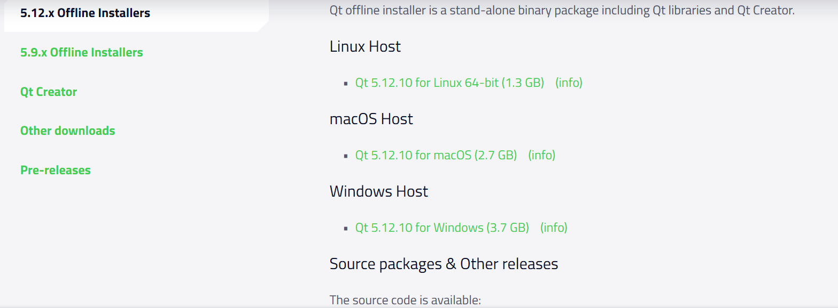
Download and install Qt Creator
QT installation divides online and offline. (Offline is recommended)
https://www.qt.io/offline-installers (From 5.15 version, Offline-installers are not supported)
I choiced QT Creator 5.12.10 as an example.
For Windows User:
https://iso.mirrors.ustc.edu.cn/qtproject/archive/qt/5.12/5.12.10/qt-opensource-windows-x86-5.12.10.exe
http://download.qt.io/official_releases/qt/5.12/5.12.10/qt-opensource-windows-x86-5.12.10.exe
For MacOS User:
https://mirrors.ustc.edu.cn/qtproject/archive/qt/5.12/5.12.10/qt-opensource-mac-x64-5.12.10.dmg
http://download.qt.io/official_releases/qt/5.12/5.12.10/qt-opensource-mac-x64-5.12.10.dmg

Slide 5
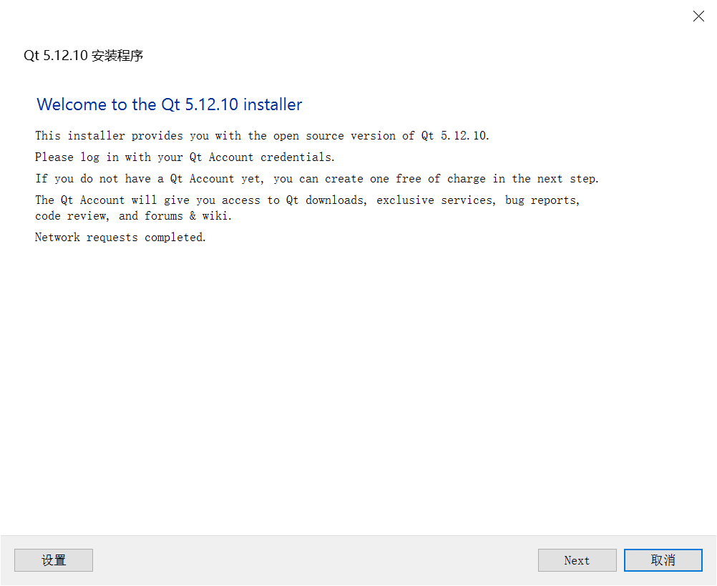
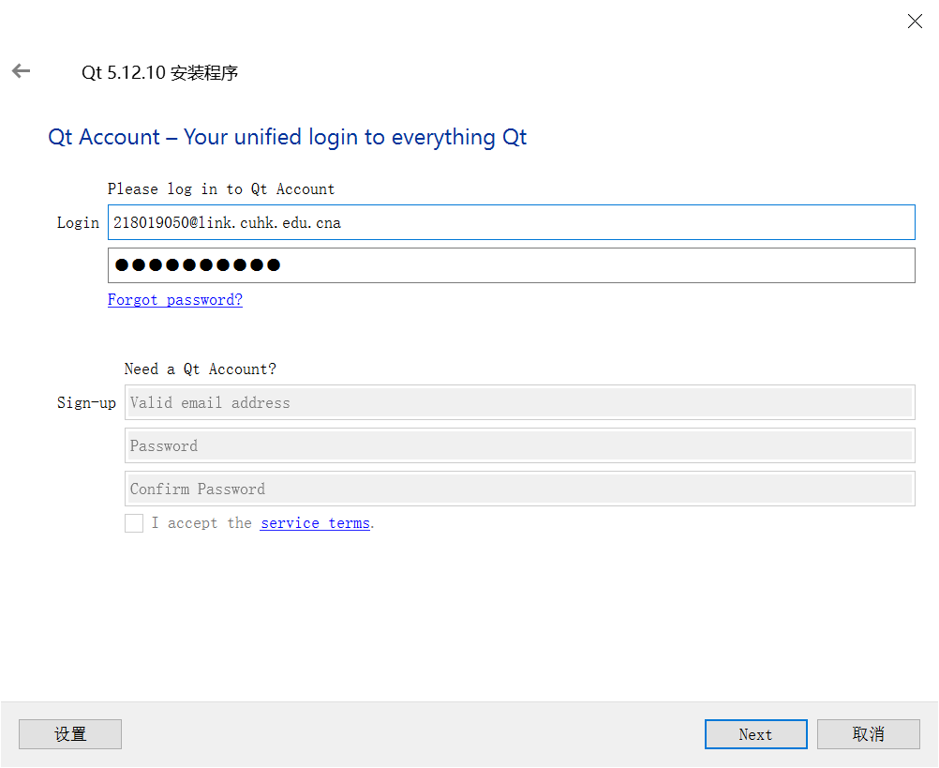
Download and install Qt Creator
Firstly, sign-up. Then, login.

Slide 6
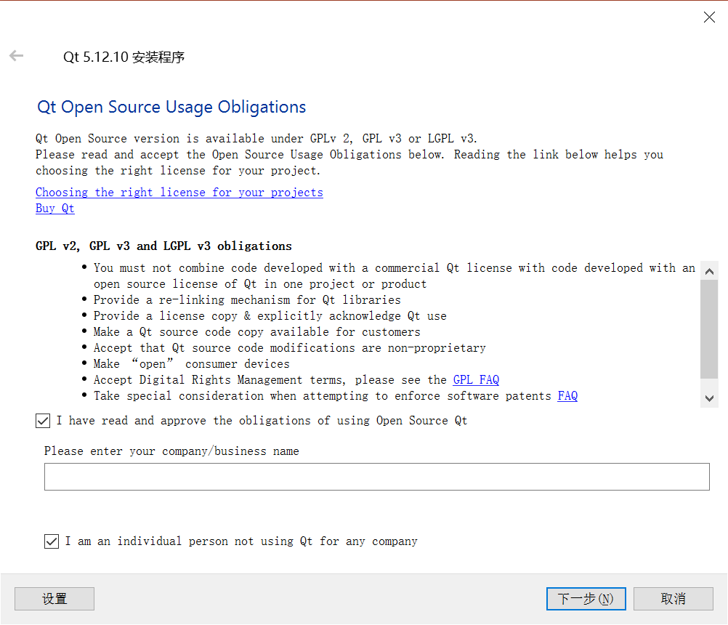
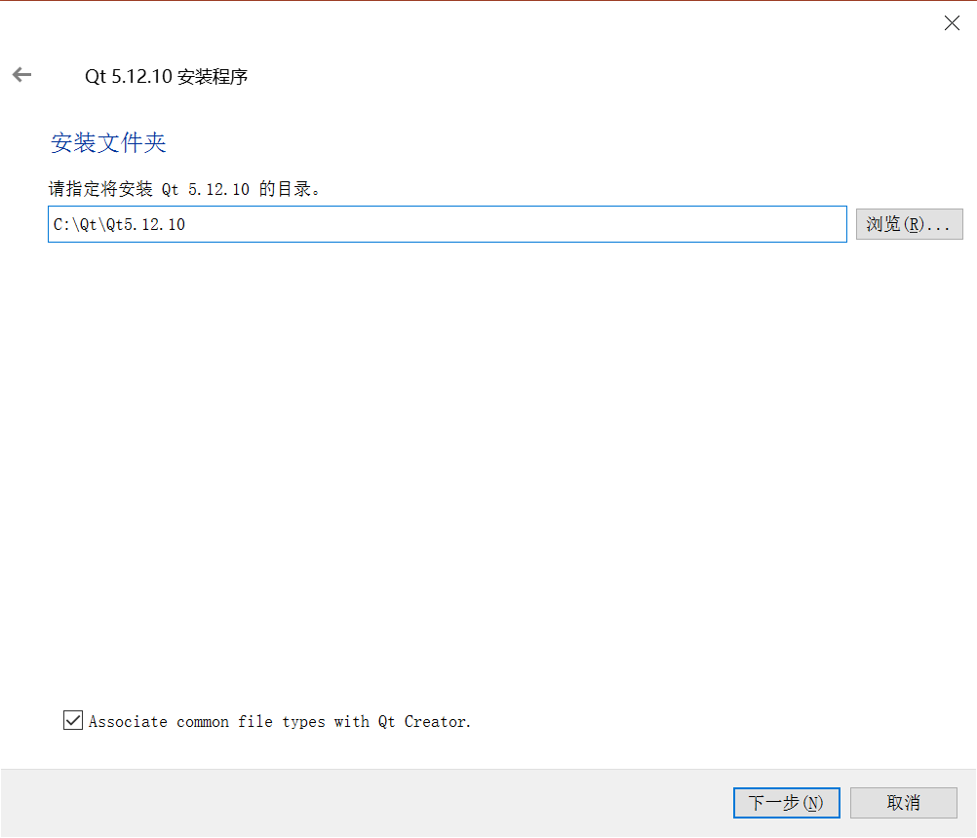
Download and install Qt Creator

Slide 7
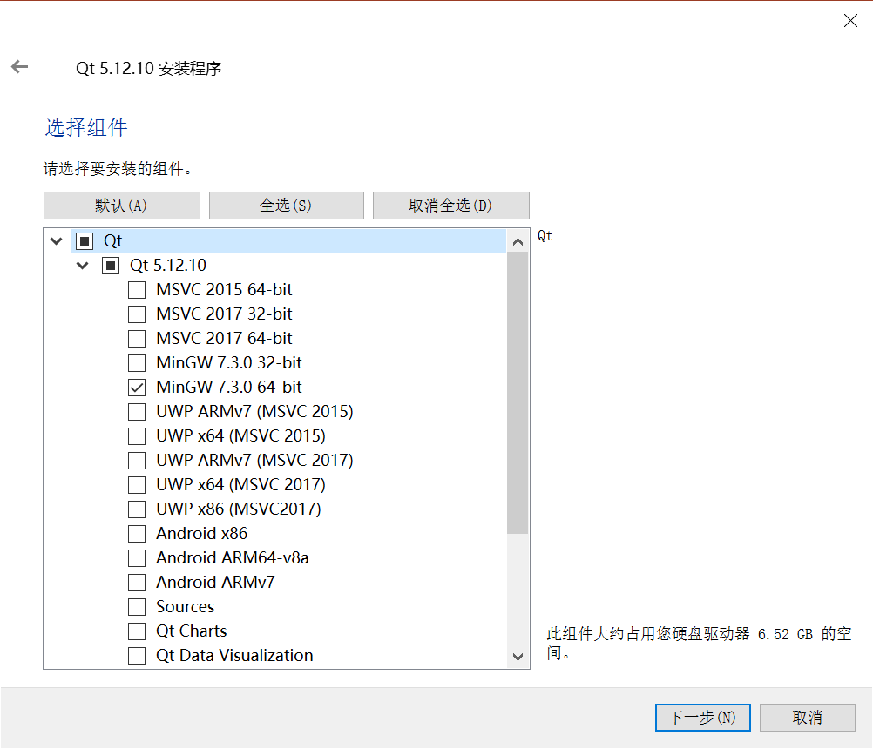
Download and install Qt Creator
Select Components (compiler)
(Install a C++ compiler called MinGW)
You must click the checkbox labeled,
“MinGW 7.x.x 64 bit”, which is absolutely crucial;
if you forget to do this,
your computer will not be able to
compile and run C++ programs.

Slide 8
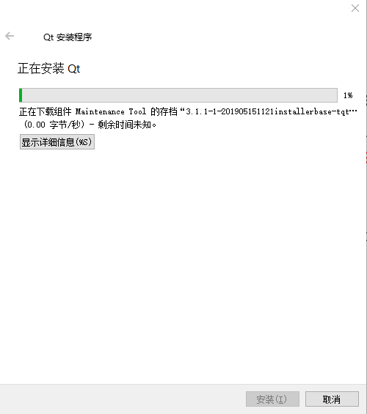
Download and install Qt Creator
Select Components (compiler)
(Install a C++ compiler called MinGW)
You must click the checkbox labeled,
“MinGW 7.x.x 64 bit”, which is absolutely crucial;
if you forget to do this,
your computer will not be able to
compile and run C++ programs.

Slide 9
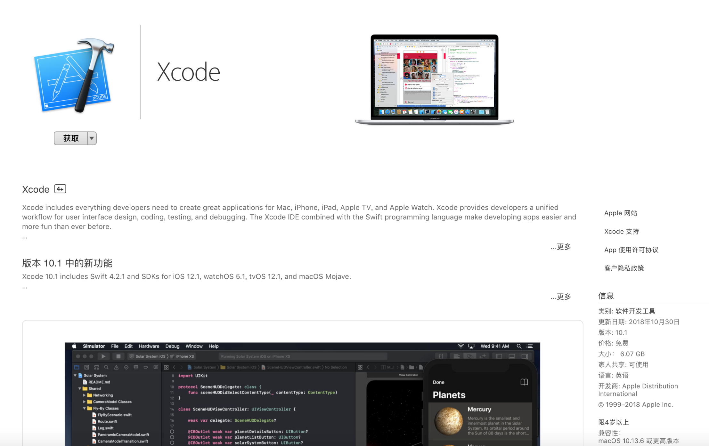
MacOS Users
Mac OS X requires you to install their Xcode system to get a C++ compiler on your machine.
You can get to the Mac App Store, find the Xcode and download it.

Slide 10
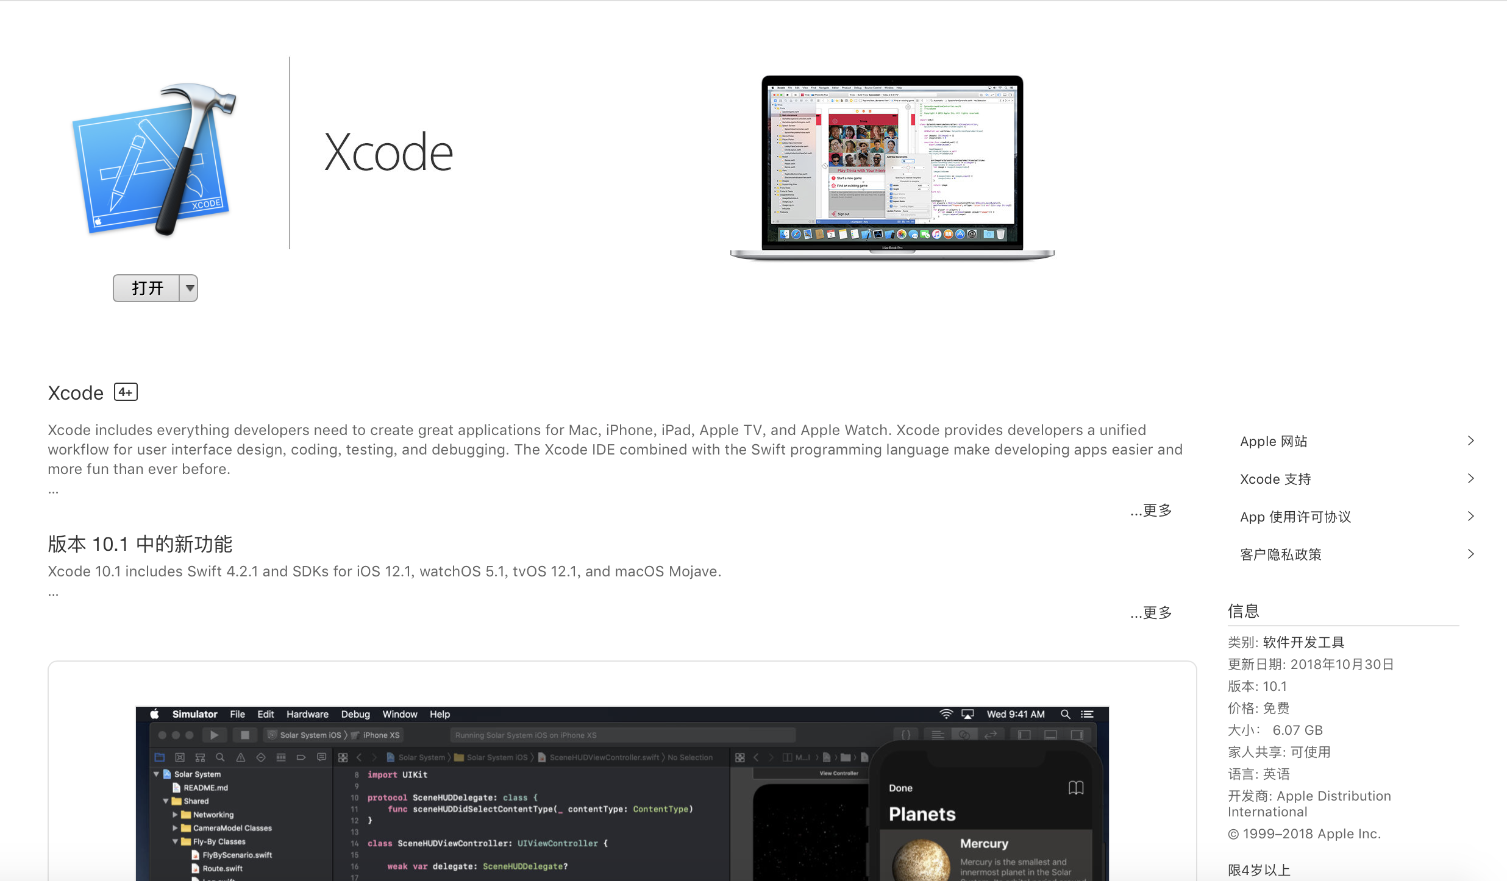
MacOS Users
Once your Xcode has installed, you have to actually launch the Xcode application one time in order to install certain essential components.

Slide 11
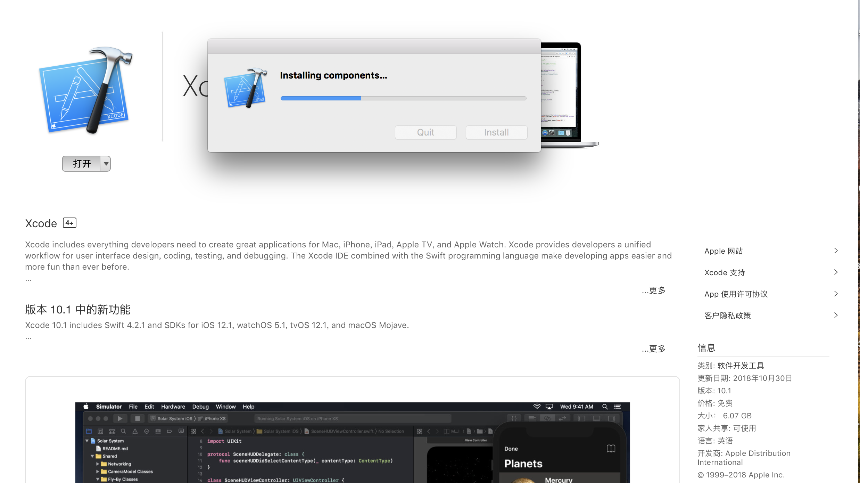
MacOS Users
Once your Xcode has installed, you have to actually launch the Xcode application one time in order to to install certain essential components.

Slide 12
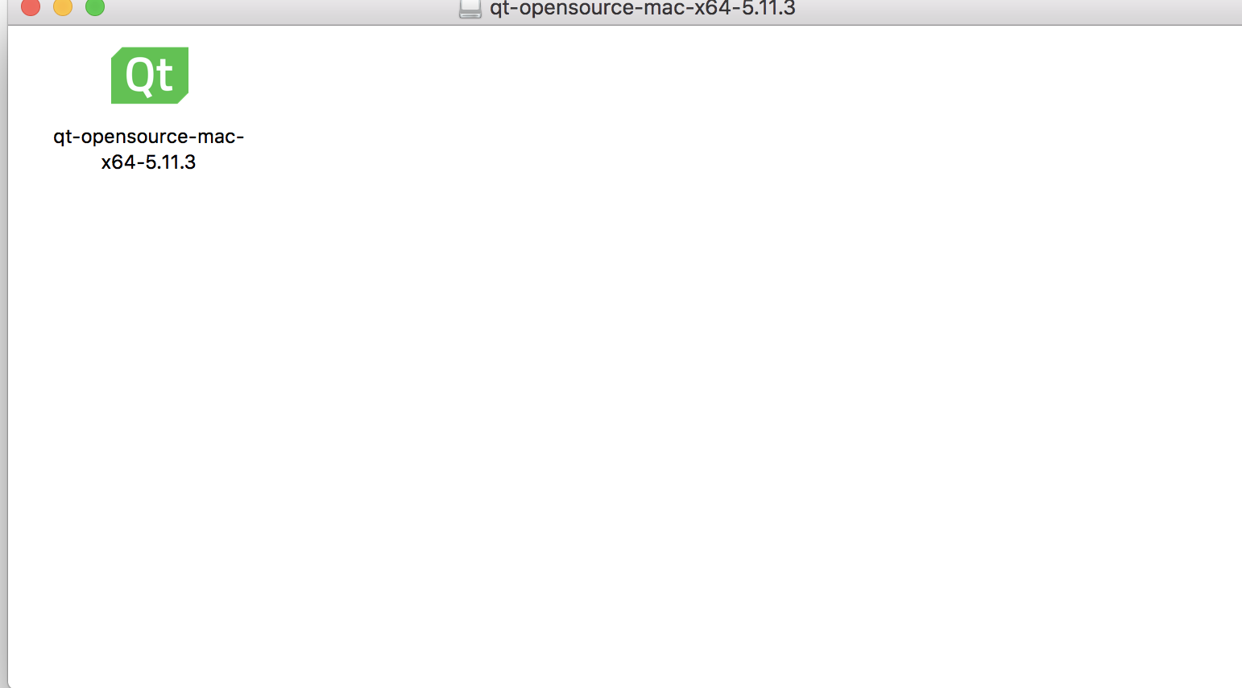
MacOS Users
Once you have downloaded the Qt Creator .dmg installer, double-click it to mount it and launch the enclosed installer application.
Use the right version downloaded by the online installer

Slide 13
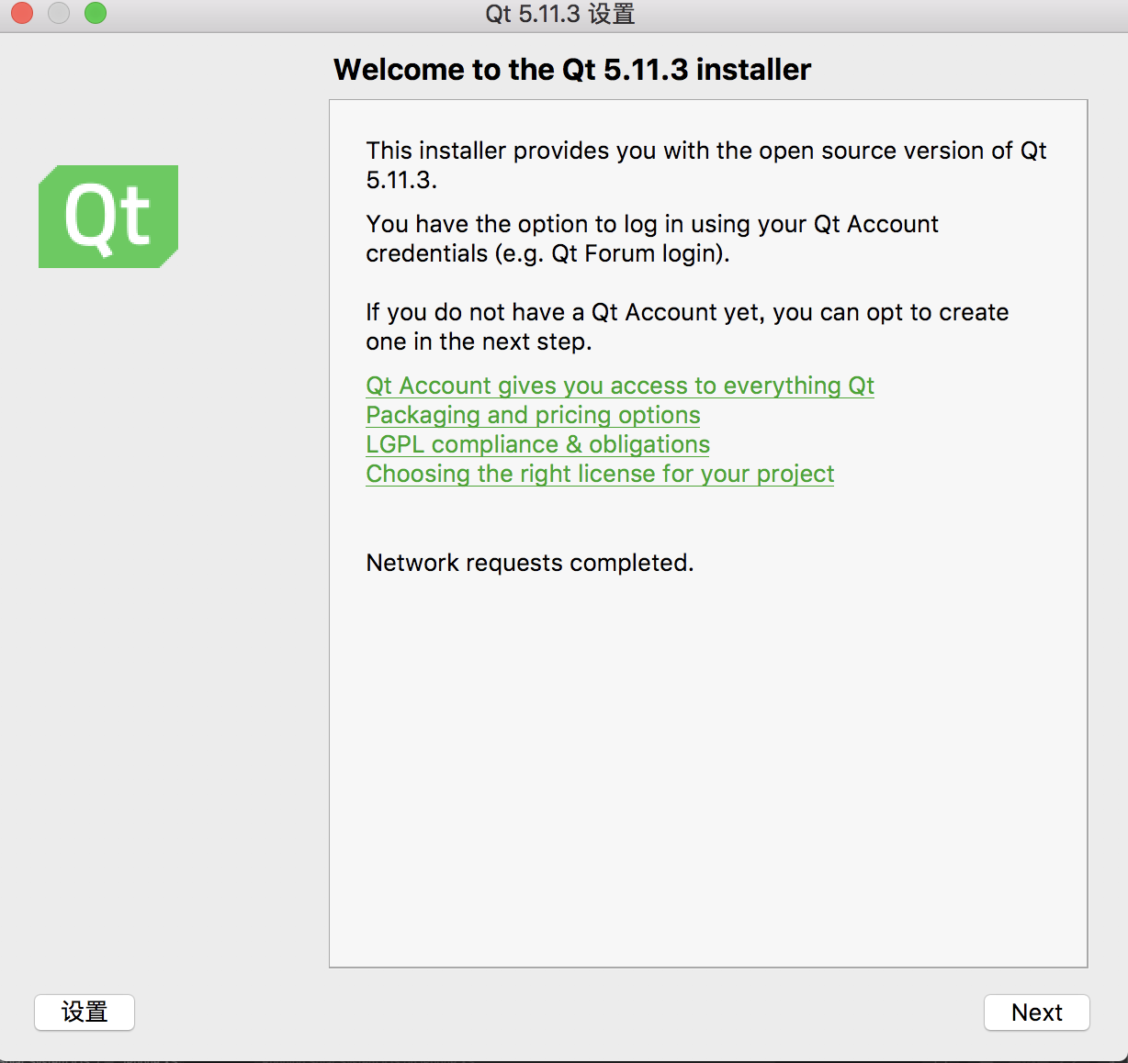
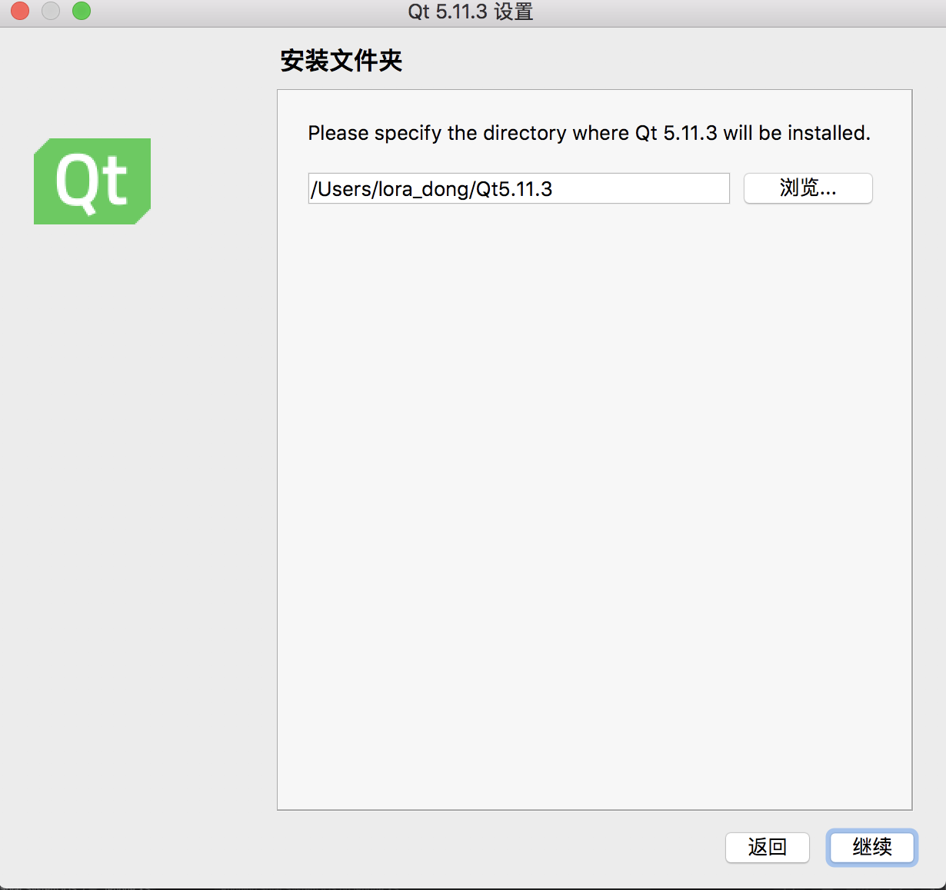
MacOS Users
Once you have downloaded the Qt Creator .dmg installer, double-click it to mount it and launch the enclosed installer application, which will install Qt Creator on your computer.

Slide 14
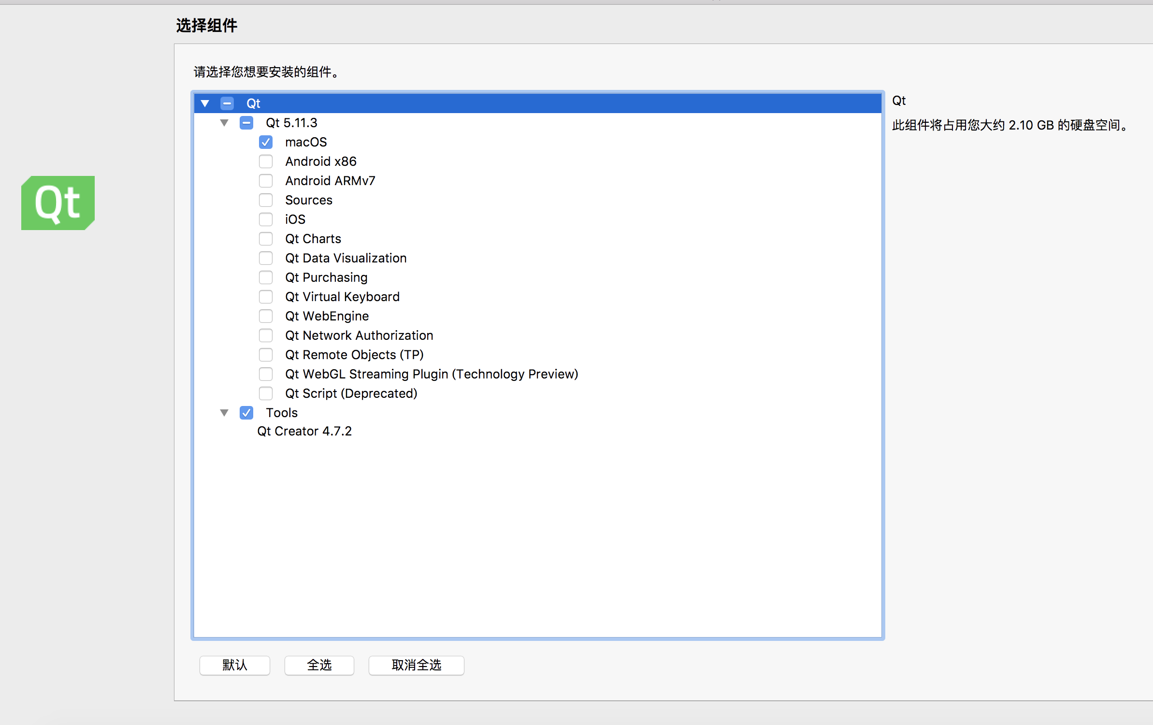
MacOS Users
Skip the registration step
at the "Select Components" screen, you must install the MacOS Component
Un-check every other checkbox except for "MacOS” if you don’t have lots of disk space.

Slide 15
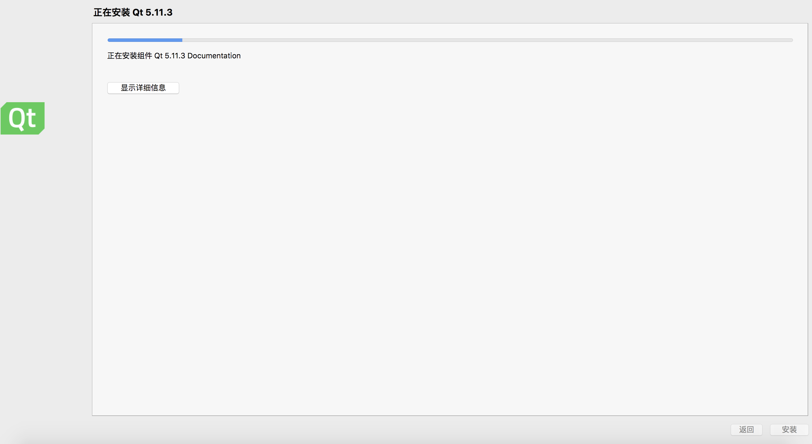
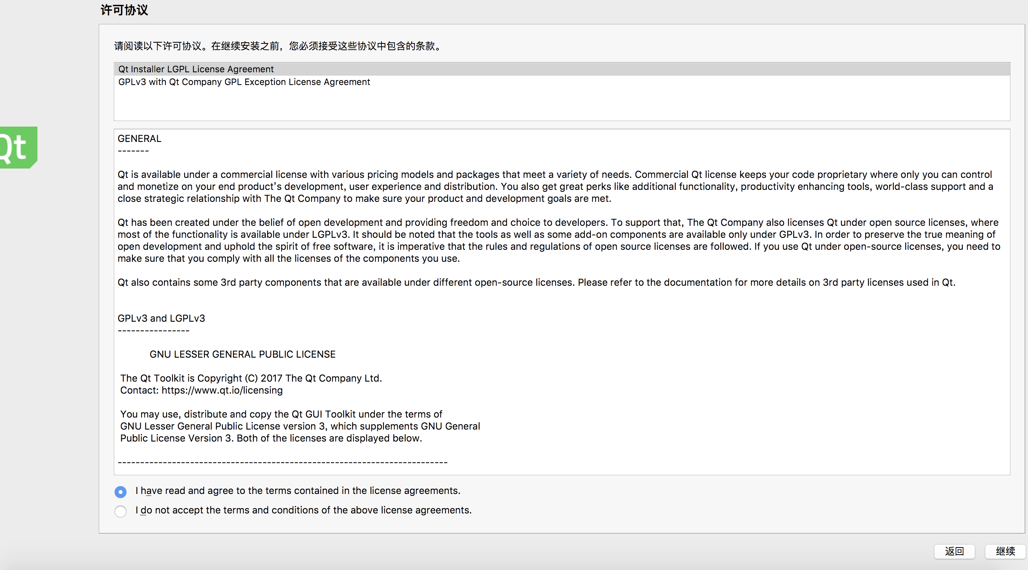
MacOS Users
Press "Next" or "Agree" or "Install" to finish the installation.
When the installation finishes, click "Done" to launch Qt Creator.

Slide 16
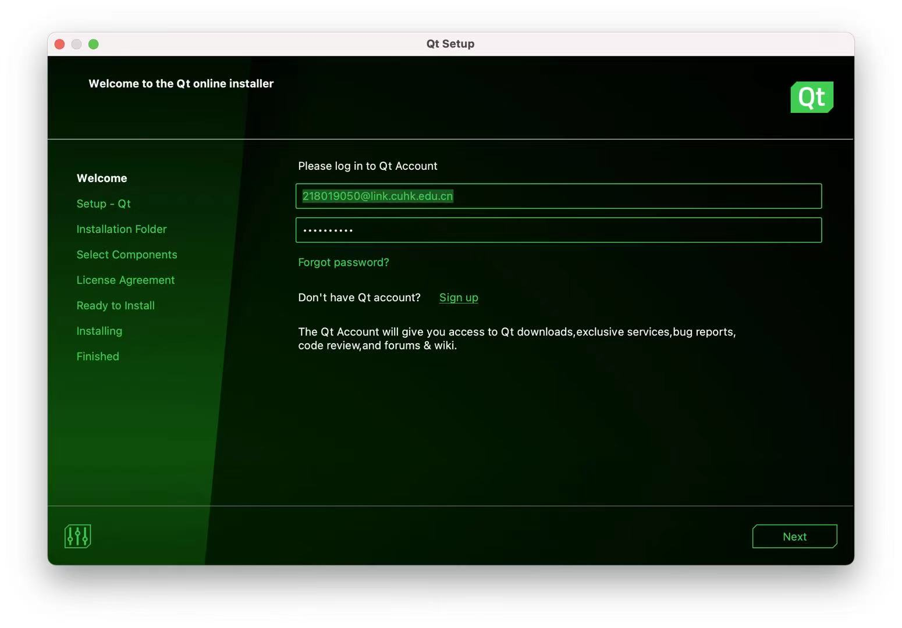
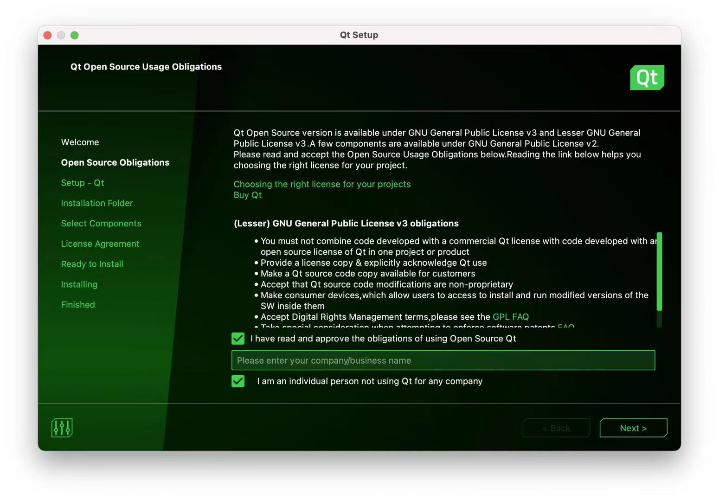
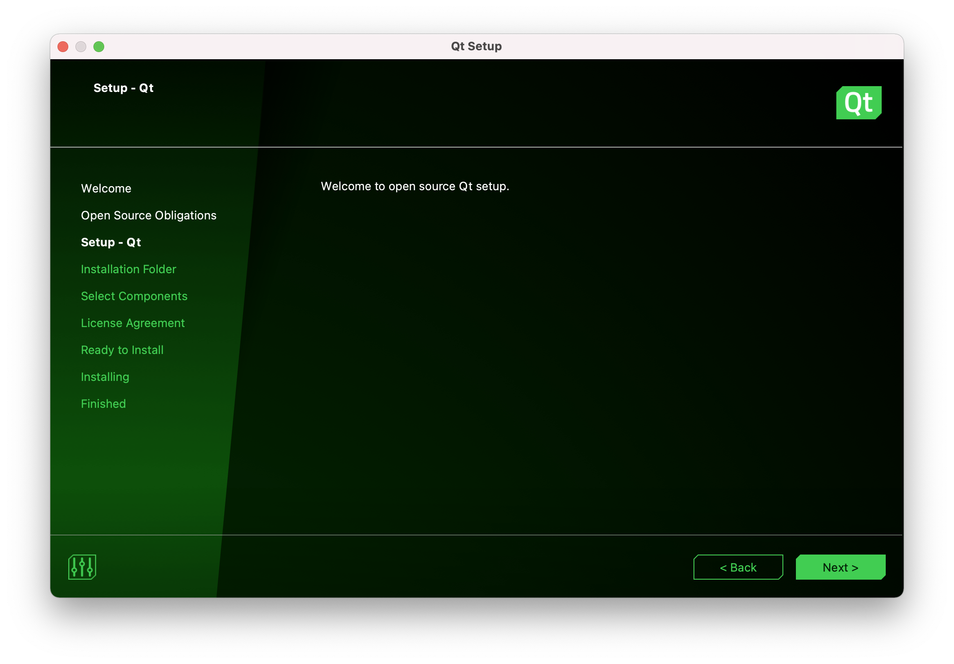
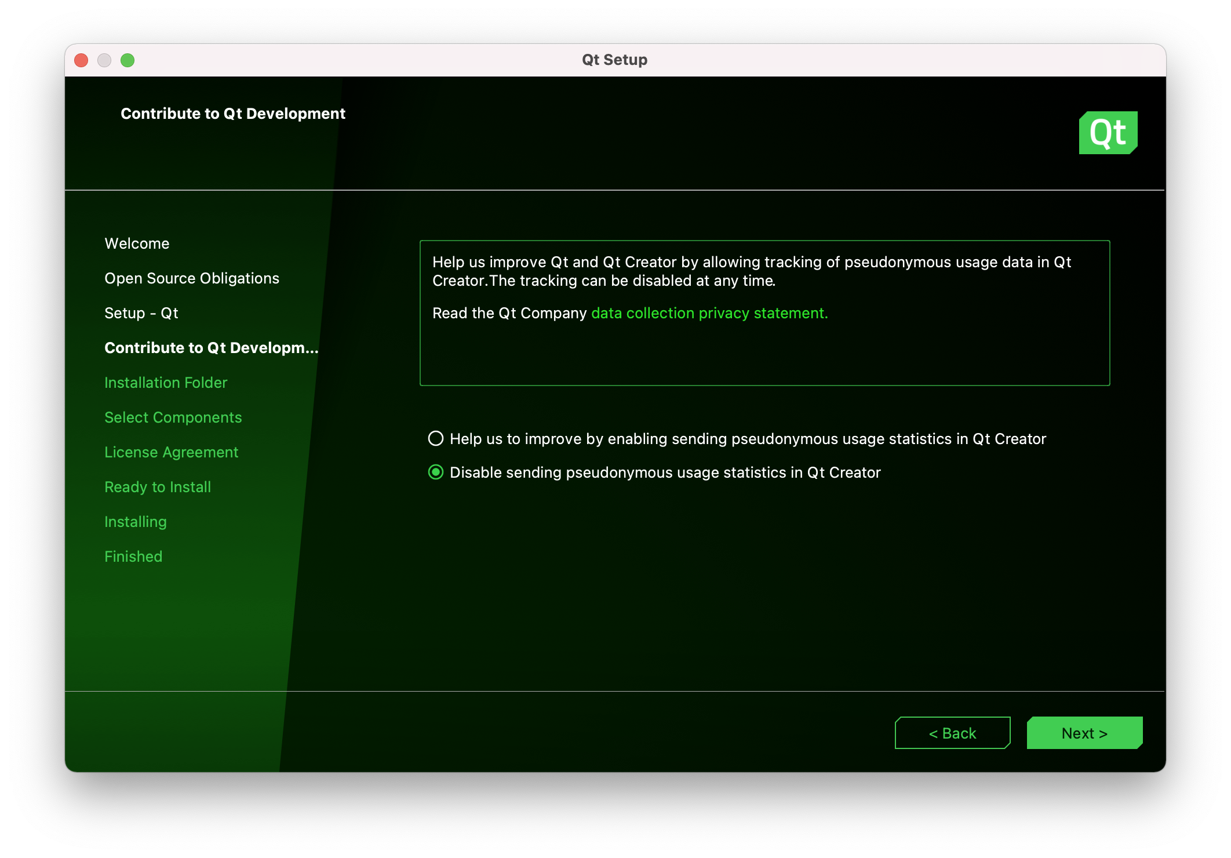
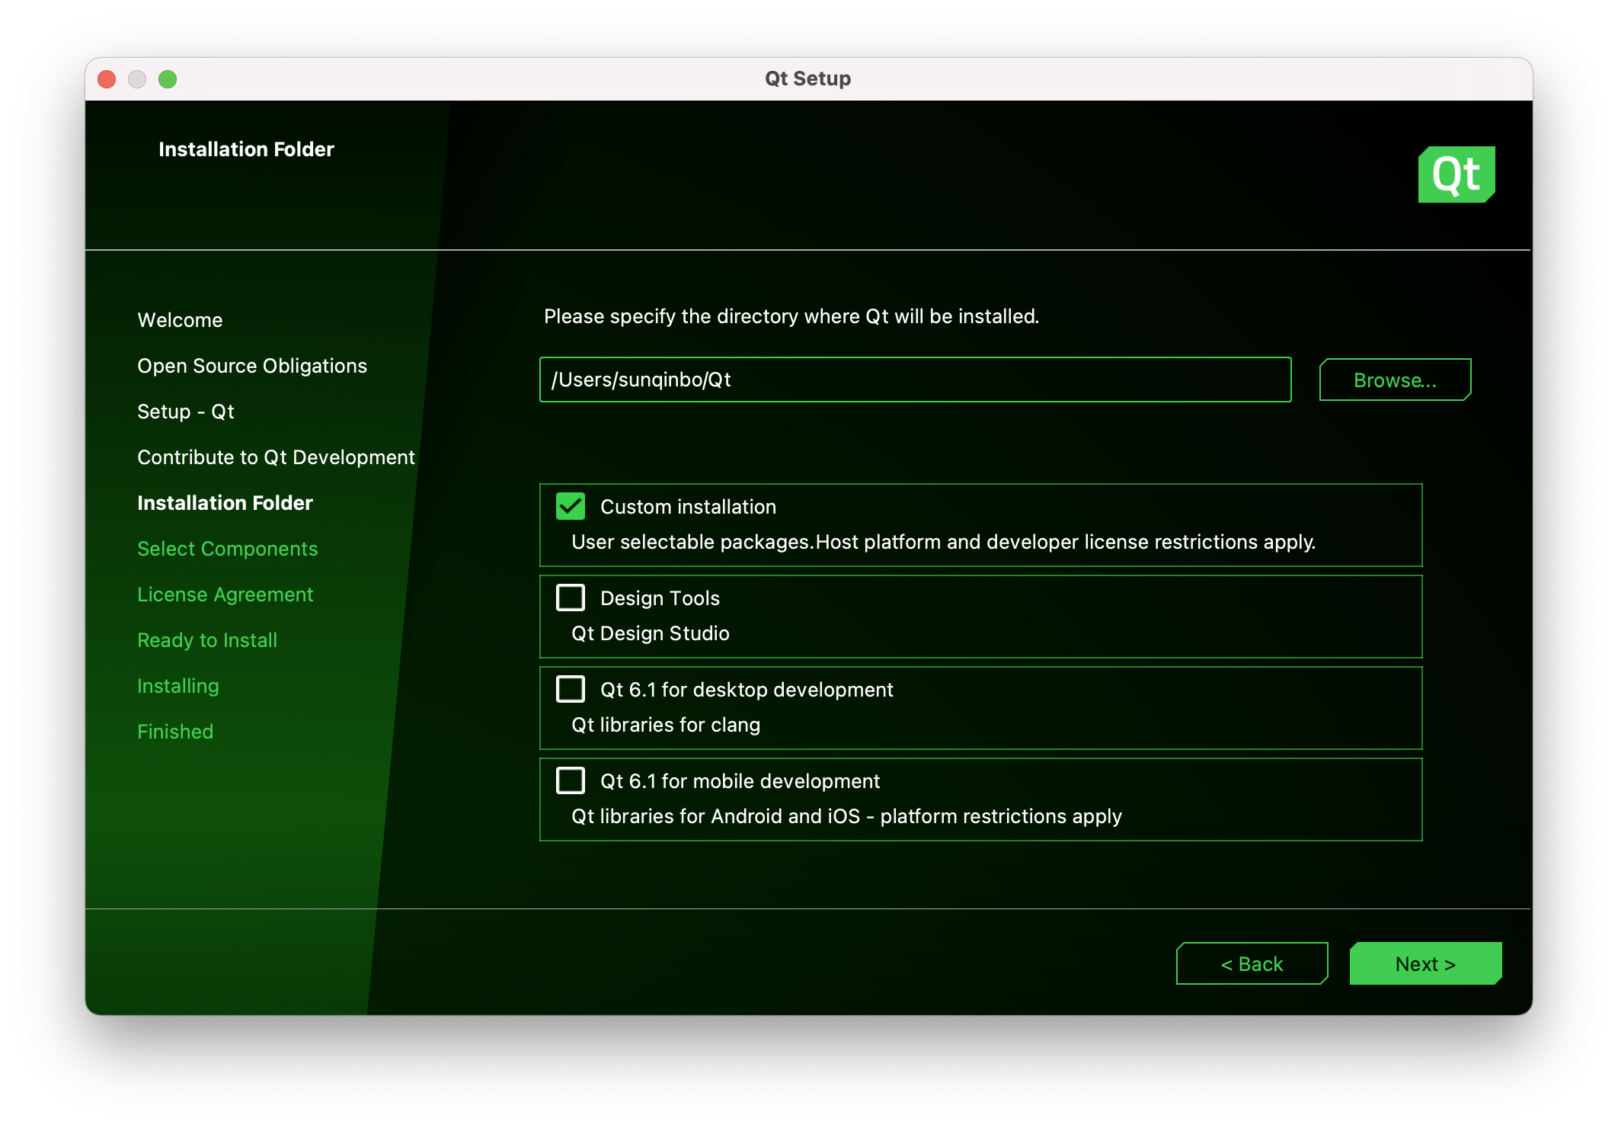
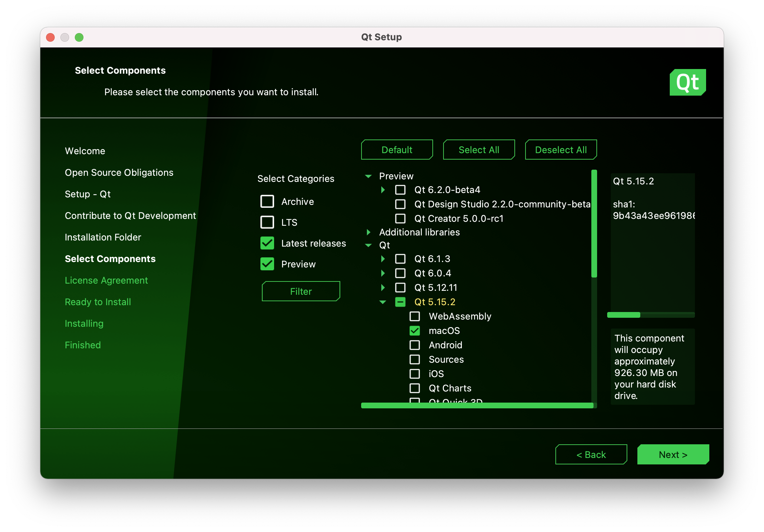
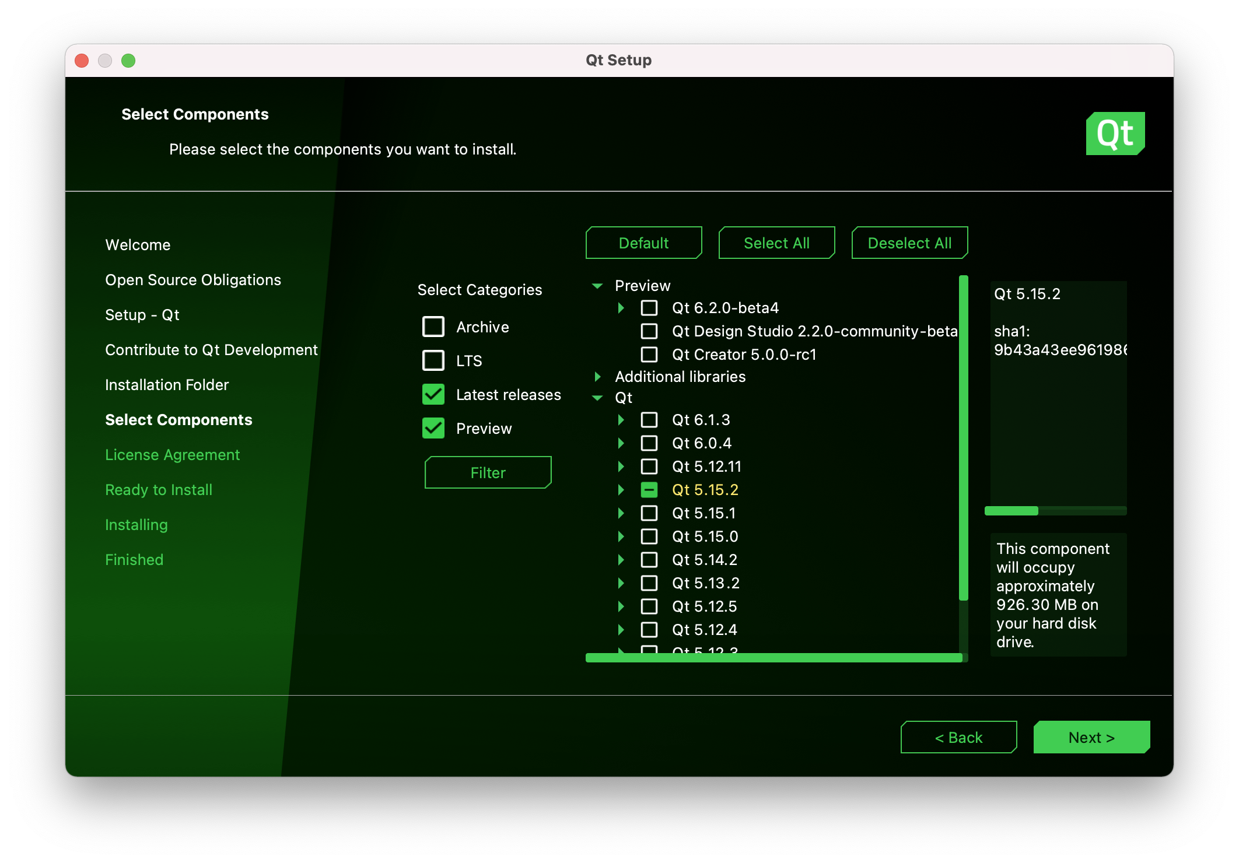
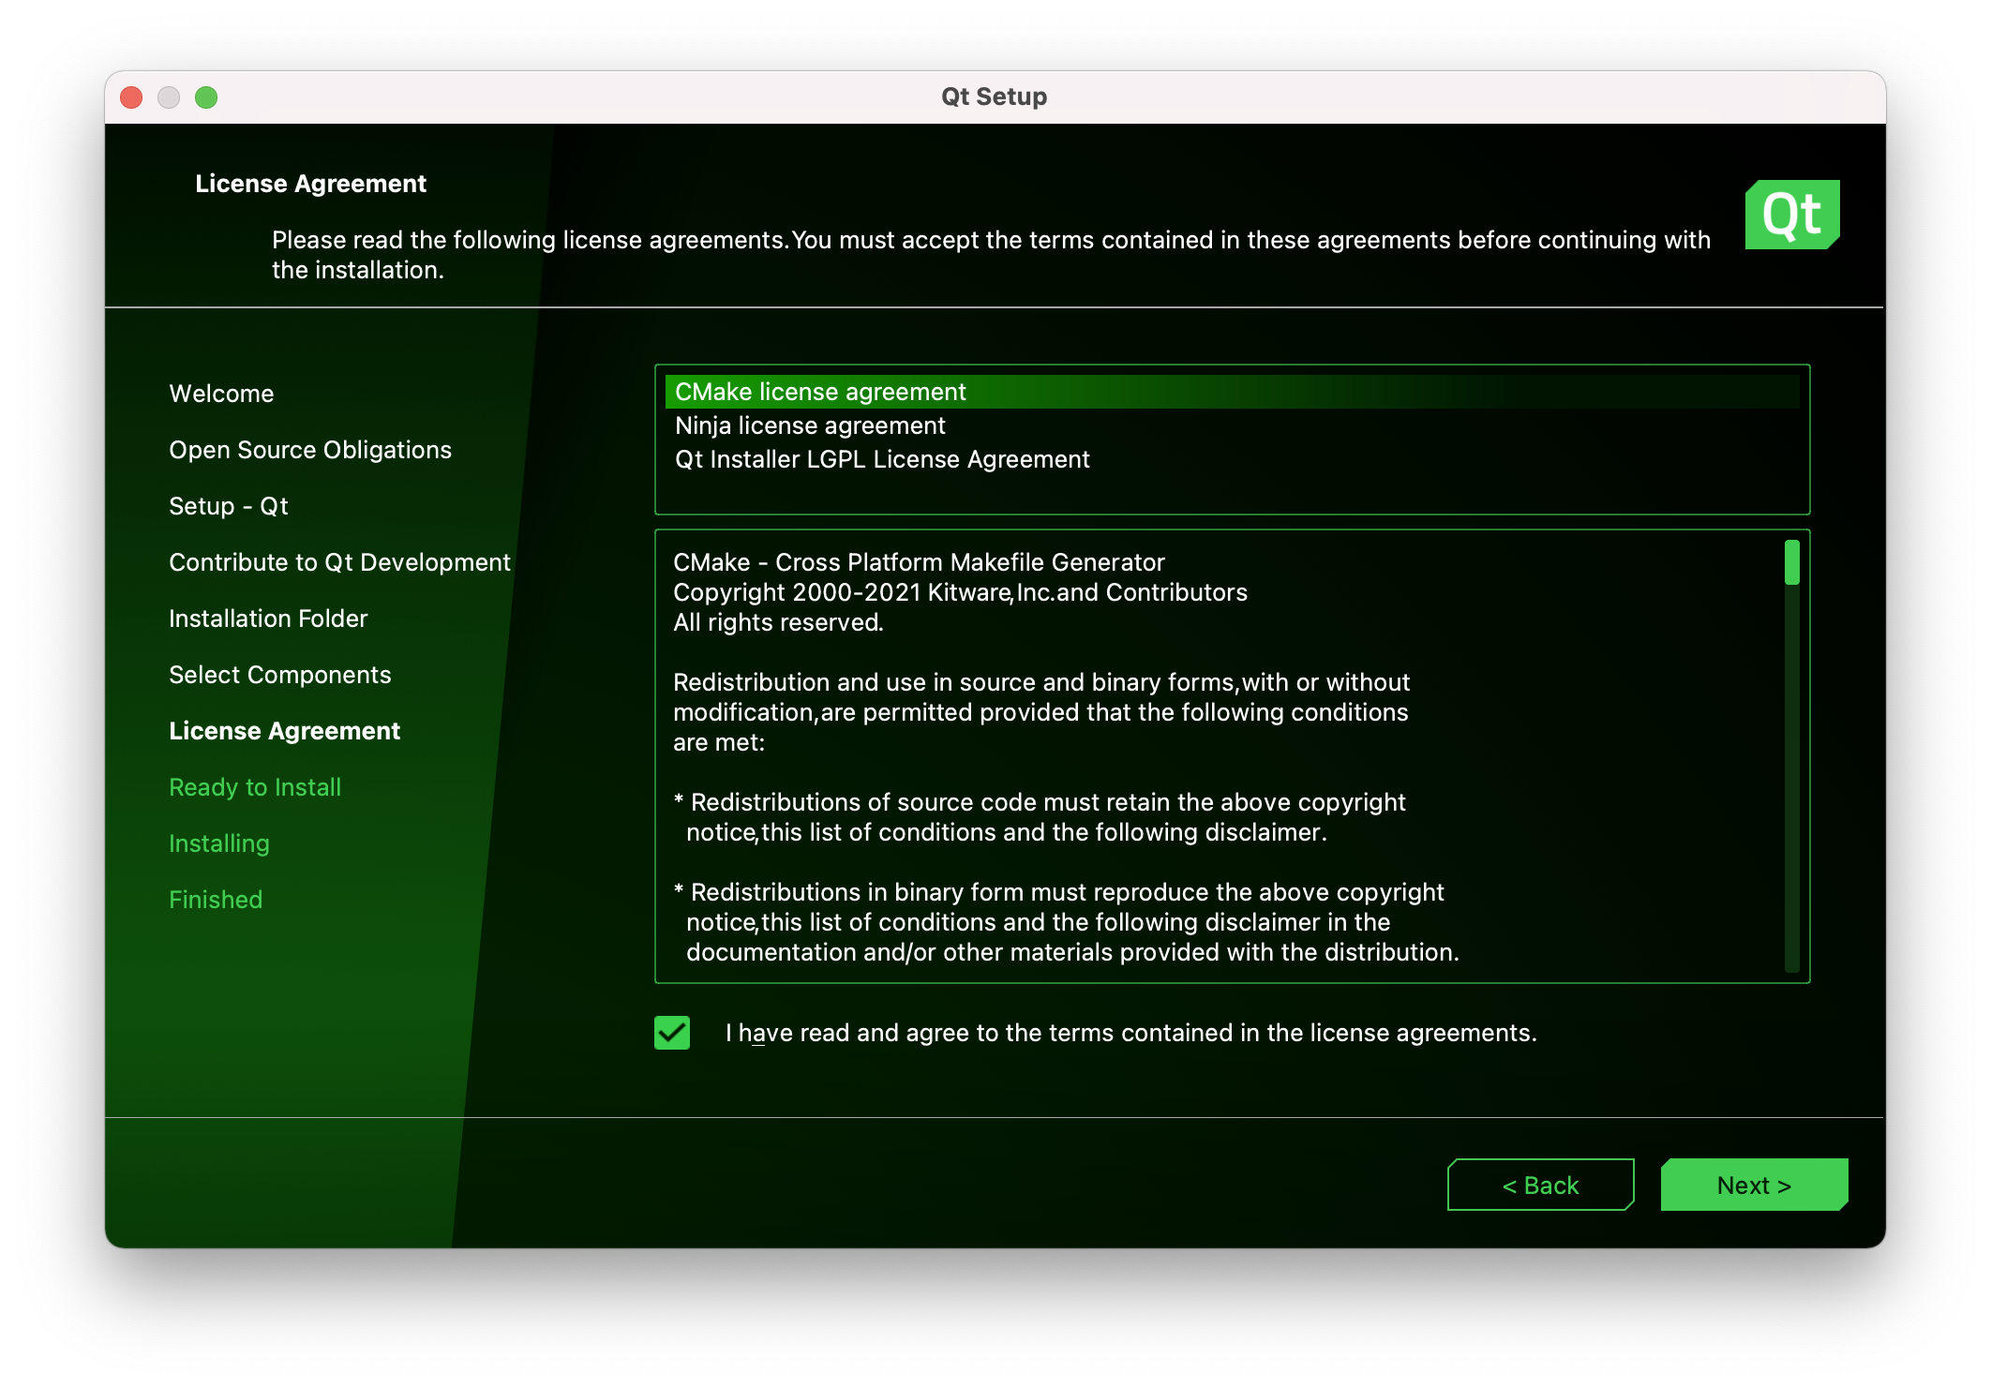
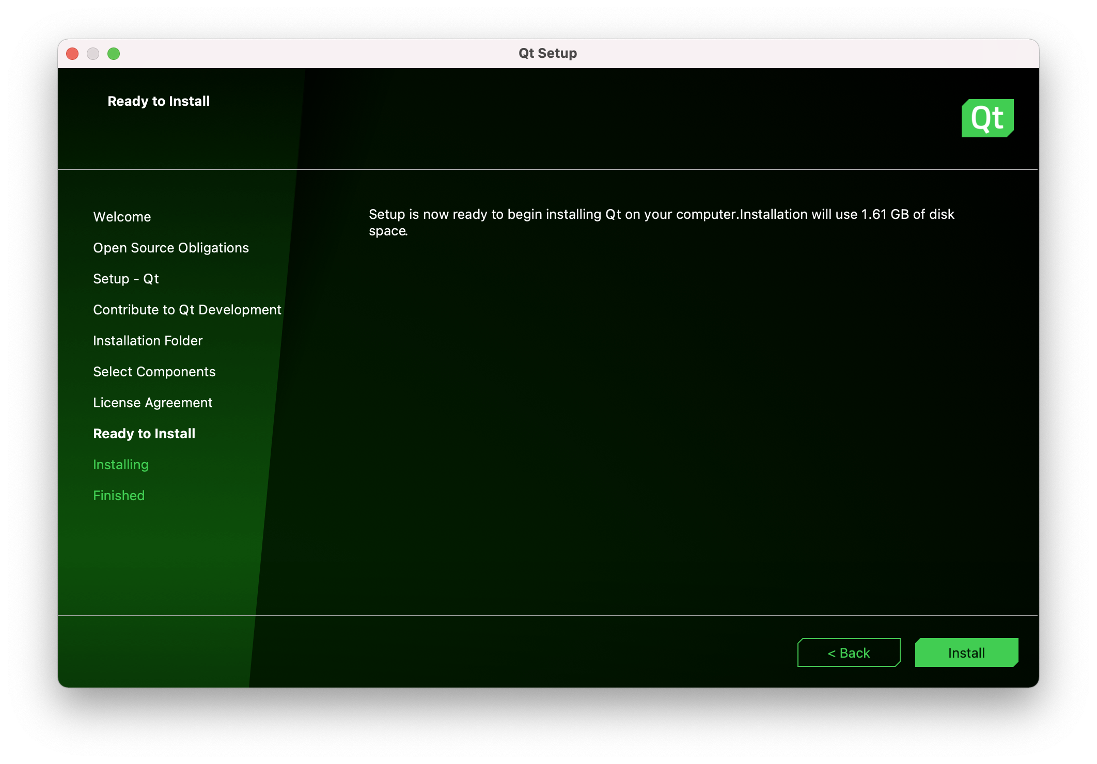
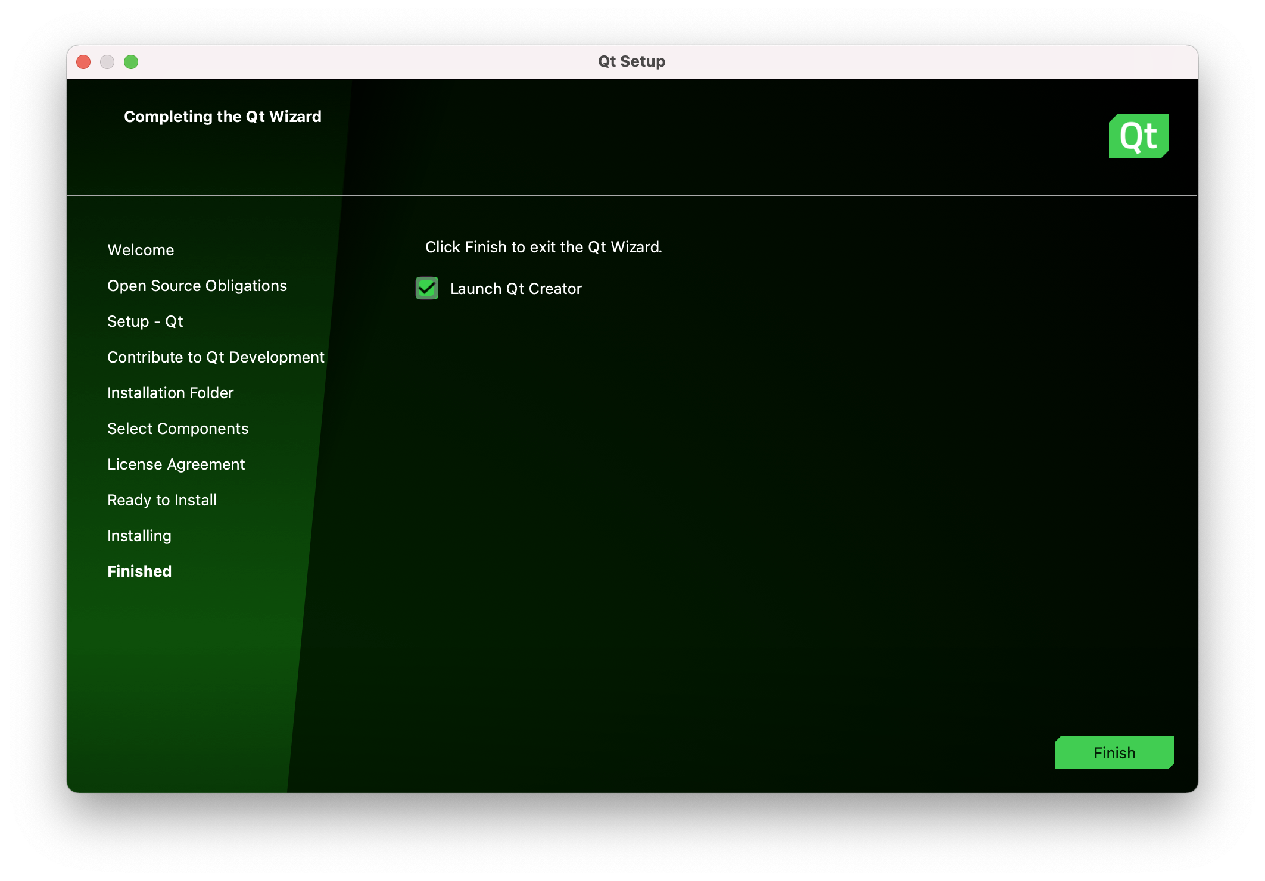
MacOS Users (with Big Sur)
If you are using Big Sur, follow the mentioned steps to install Xcode.
Then, we suggest you using the 5.15 version from the official website to download the online-installer. (https://www.qt.io/download).
Find ”Download for open source users”-”Go Open Source”-”Sign up or Login in”-”Download will be started automictically”.
Following the steps below to install.

Slide 17
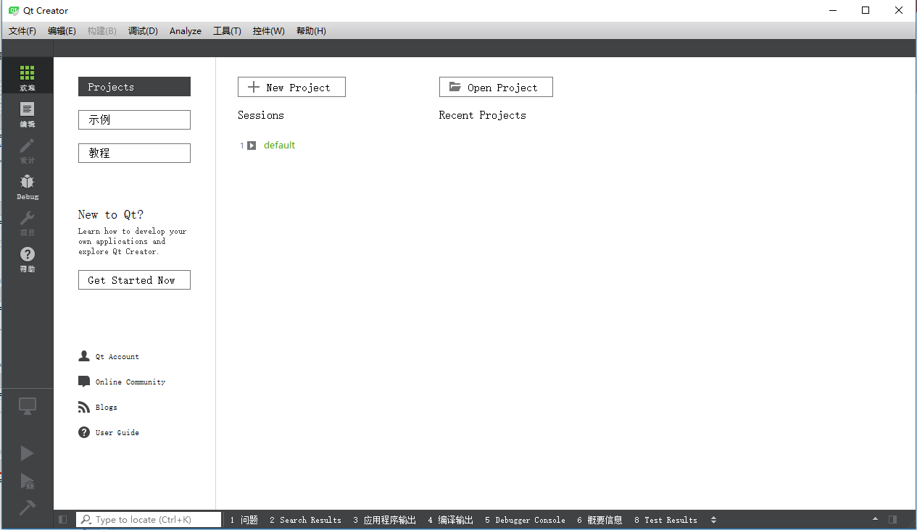
Try an new project

Slide 18
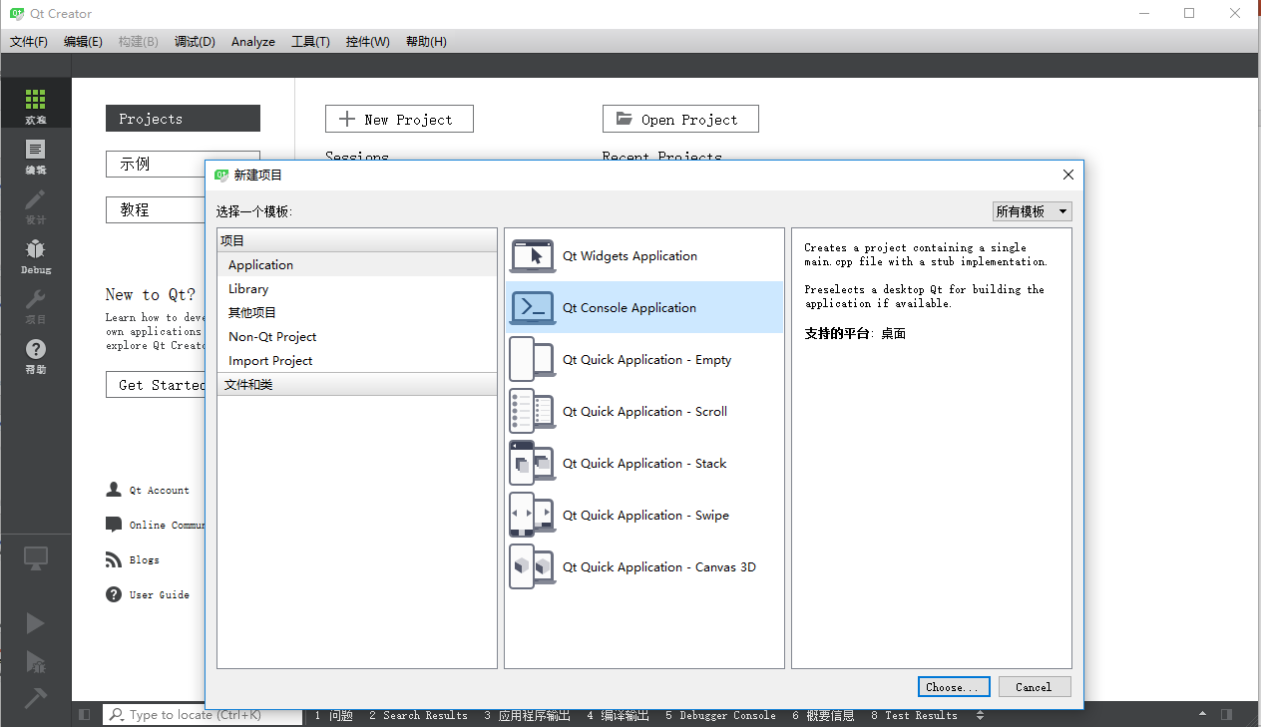
Create a simple project and Test

Slide 19
Create a simple project and Test

Slide 20
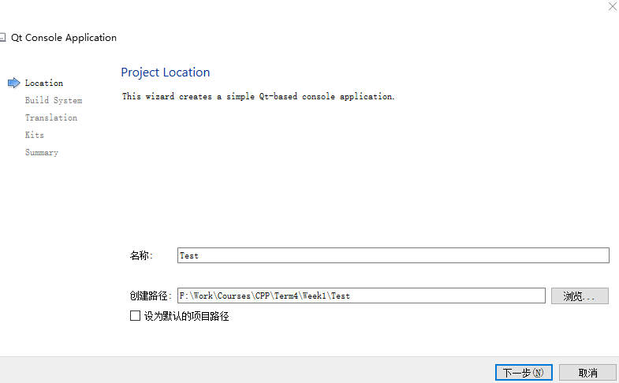
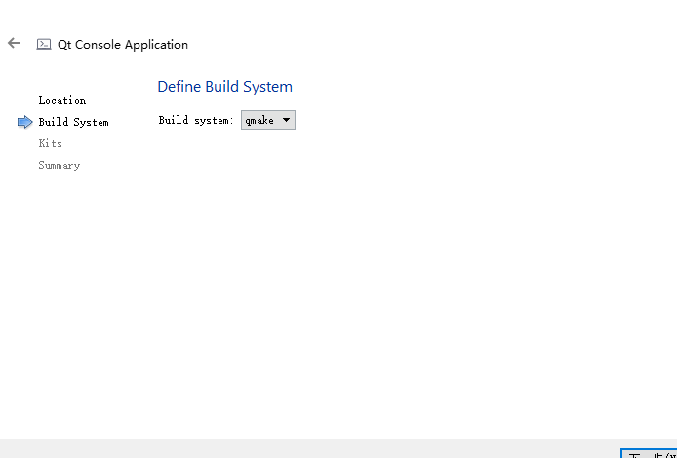
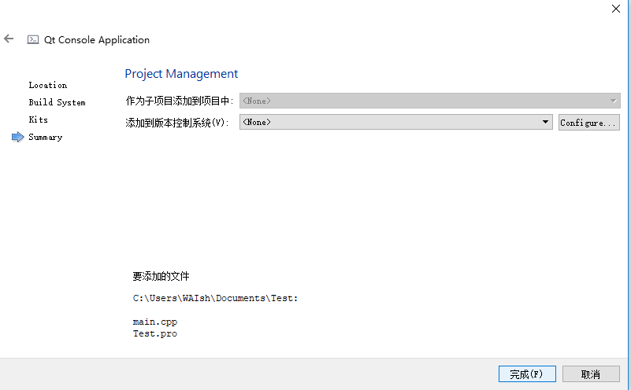
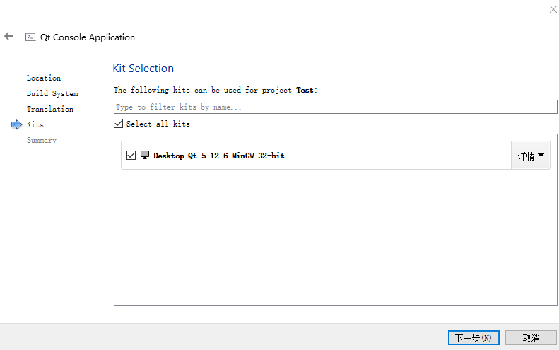
Create a simple project and Test

Slide 21
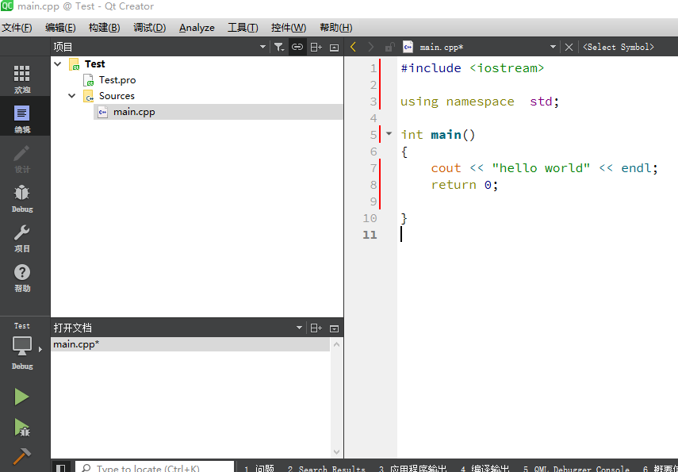
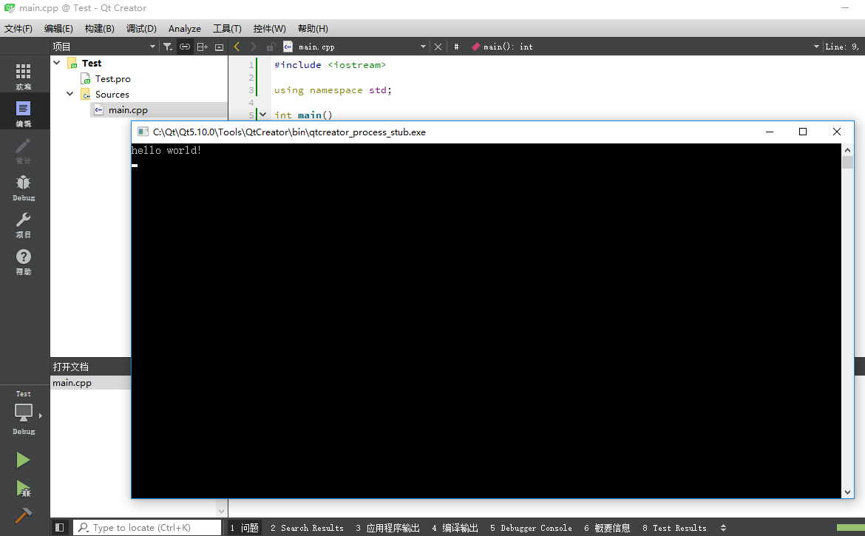
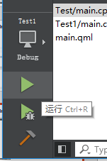
Create a simple project and Test

Slide 22
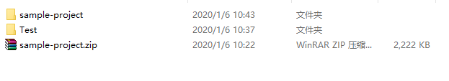
How to use The Stanford C++ Library ?
You are provided with a simple project which is equipped with the Stanford C++ Library.

Slide 23
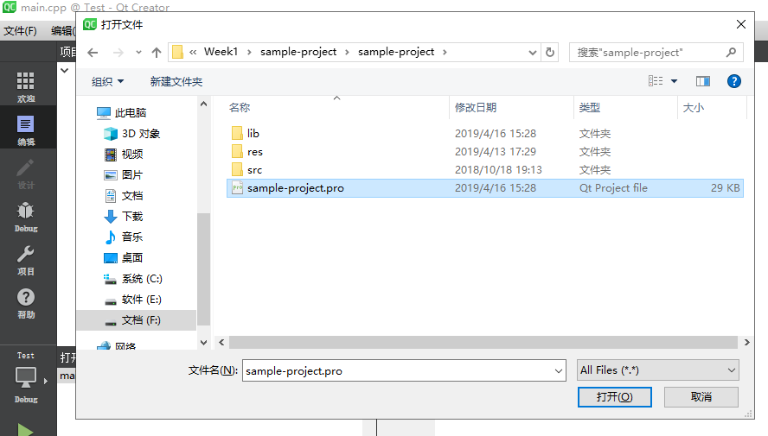
How to use The Stanford C++ Library ?

Slide 24
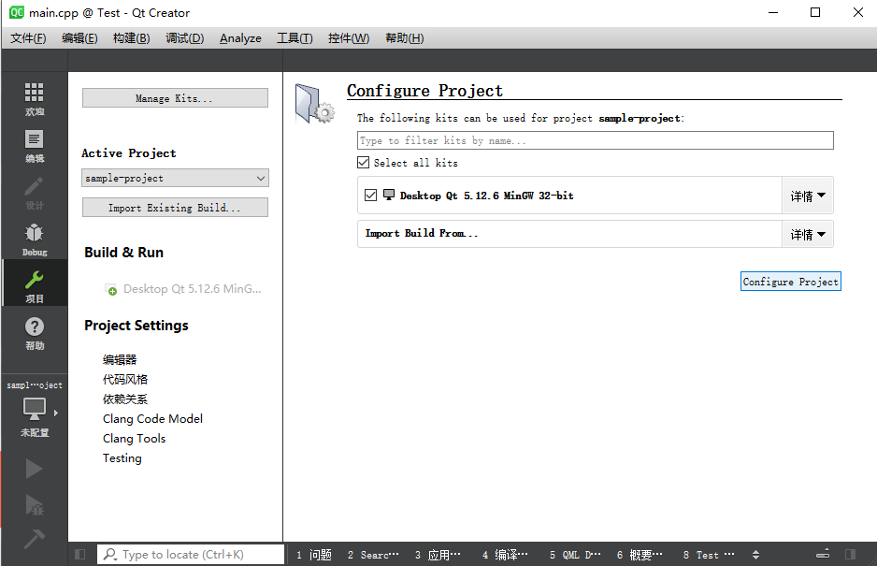
How to use The Stanford C++ Library ?

Slide 25
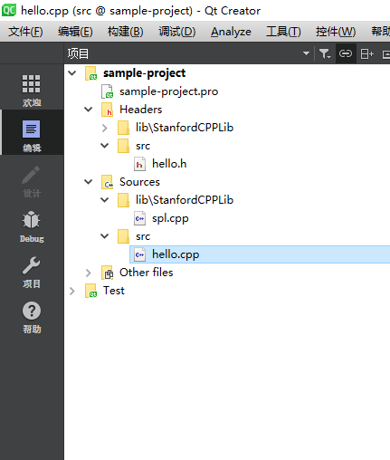
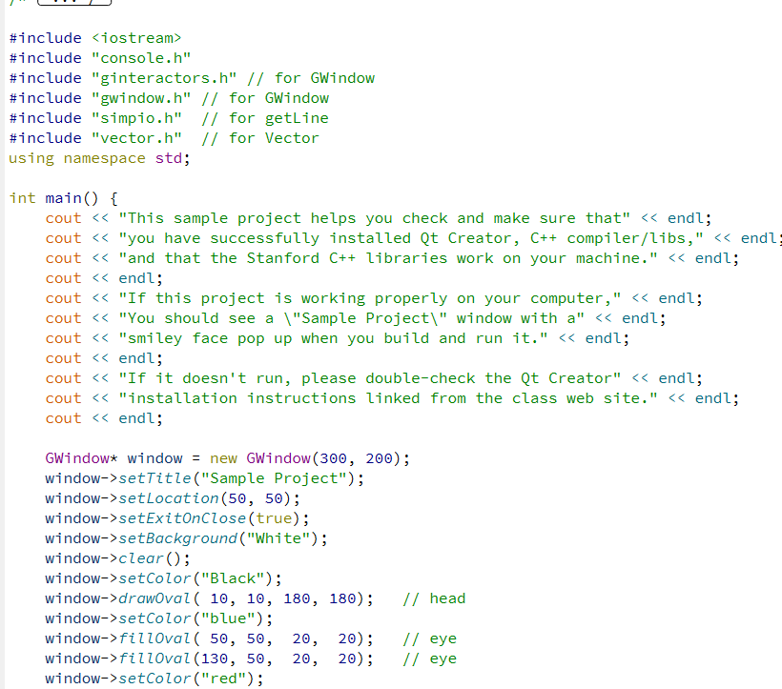
The Stanford C++ Library ?

Slide 26
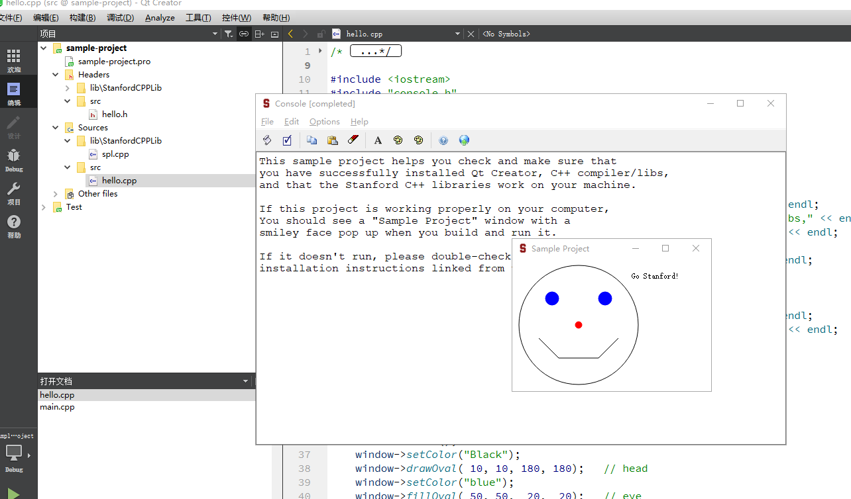
How to use The Stanford C++ Library ?

Slide 27
How to use The Stanford C++ Library ?
You can
change the project name
change the code in the main.cpp
add new files in the project
……
to use The Standford C++ Library

Slide 28
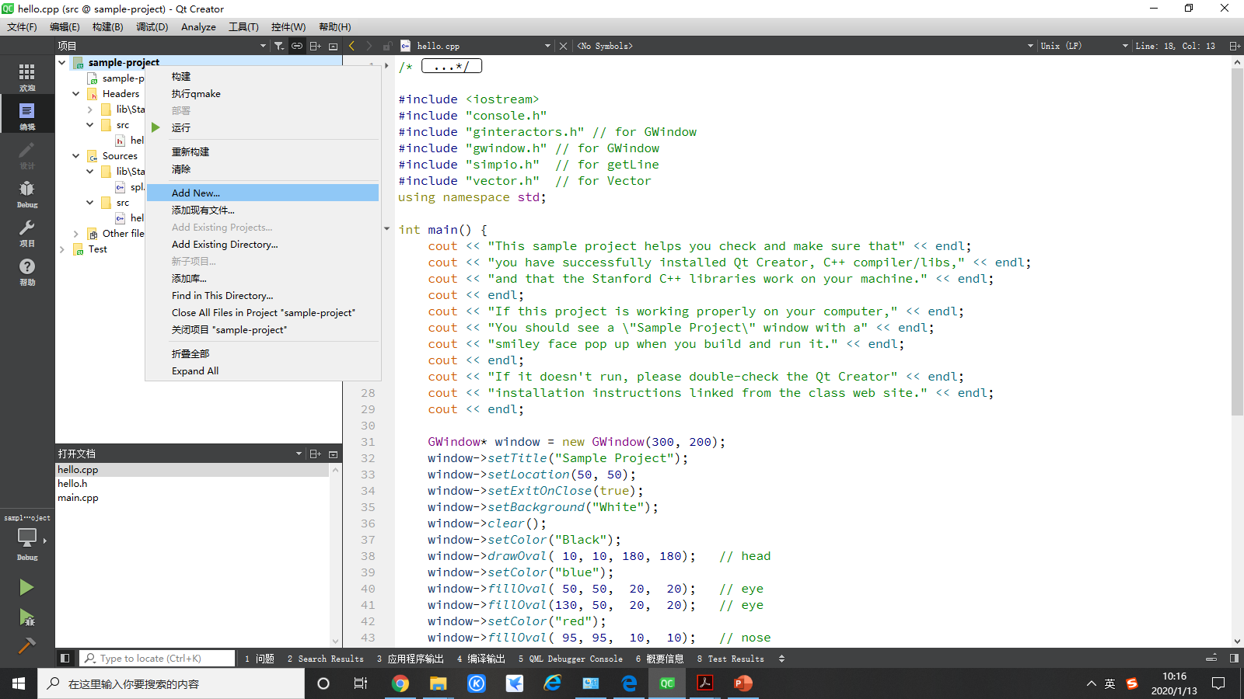
How to use The Stanford C++ Library ?
Add CPP files

Slide 29
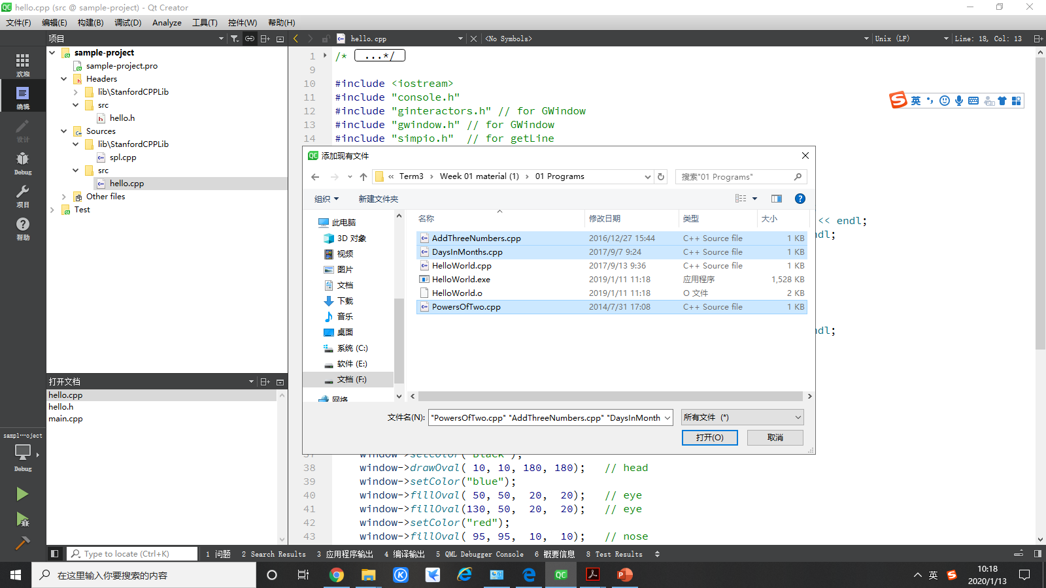
How to use The Stanford C++ Library ?
Add CPP files
The files are provided in Programs folder.

Slide 30
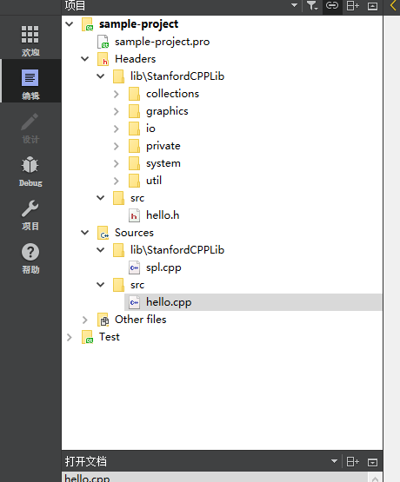
How to use The Stanford C++ Library ?
Add CPP files
Wrong！！！
Why ？？

Slide 31
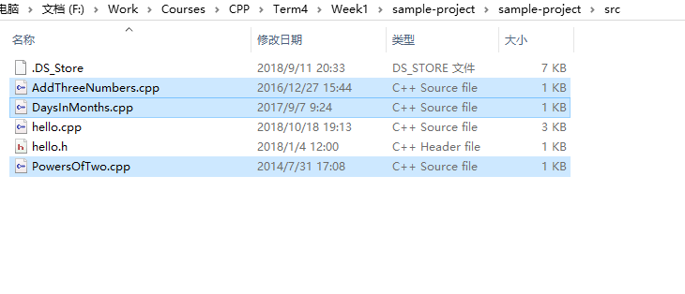
How to use The Stanford C++ Library ?
Add CPP files
First, you should put the files under the sample-project.
…/sample-project/src

Slide 32
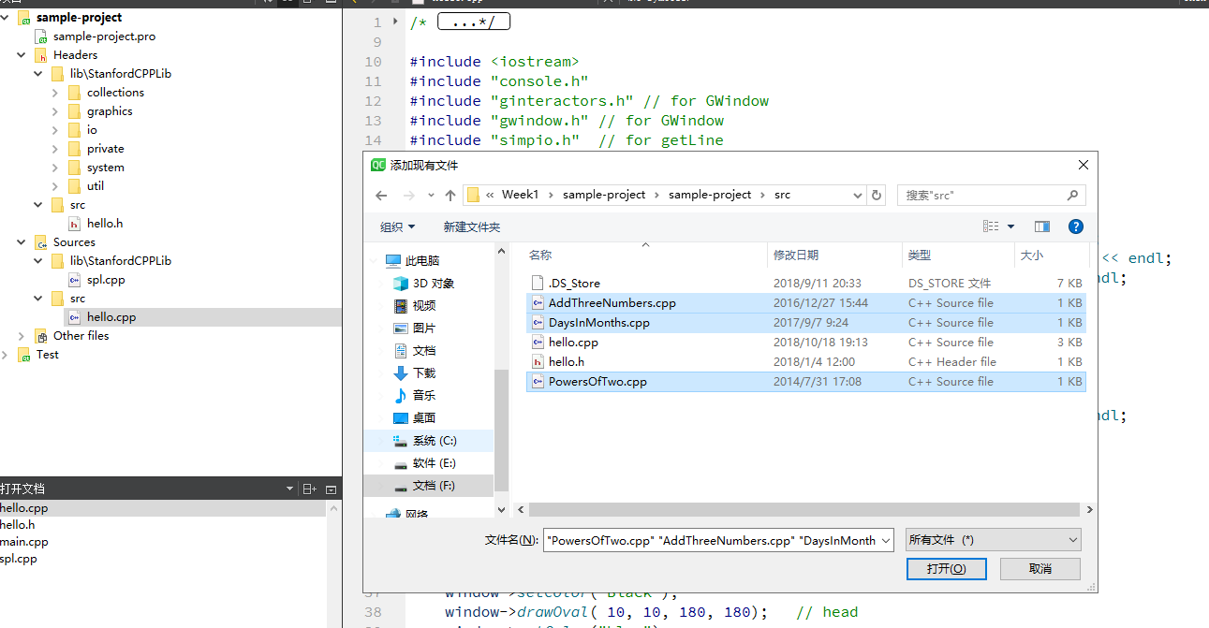
How to use The Stanford C++ Library ?
Add CPP files
Putting the files is not enough.

Slide 33
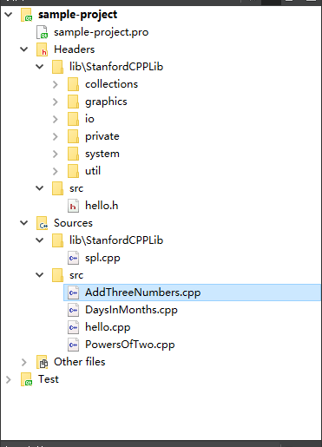
How to use The Stanford C++ Library ?
Add CPP files
Putting the files is not enough.
Right!

Slide 34
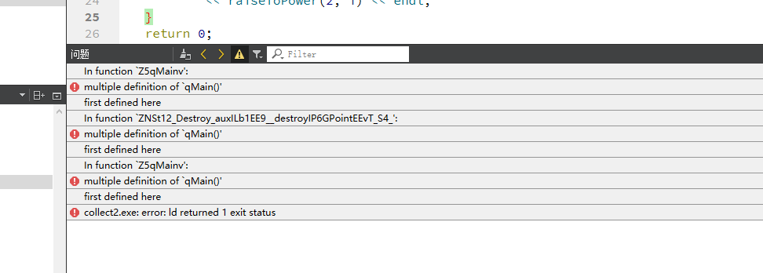
How to use The Stanford C++ Library ?
Add CPP files
Multiple definitions of main function

Slide 35
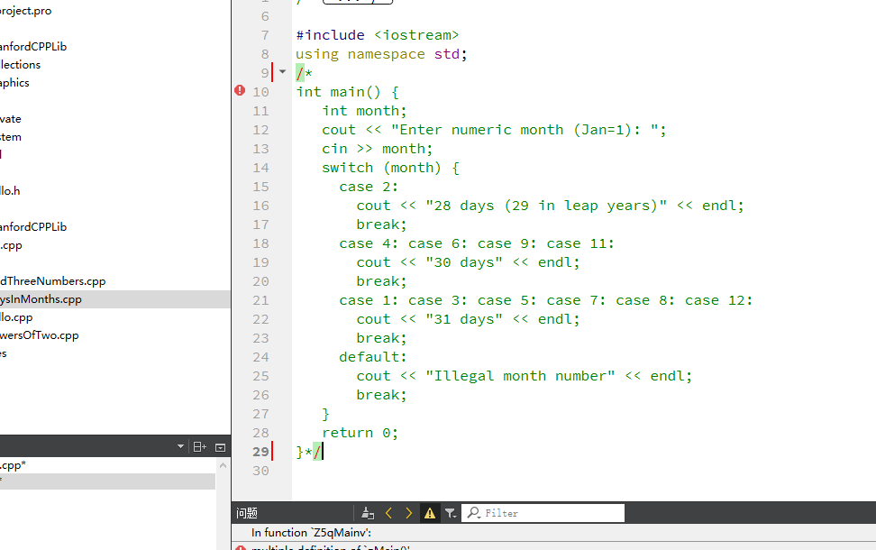
How to use The Stanford C++ Library ?
Add CPP files
Multiple definitions of main function

Slide 36
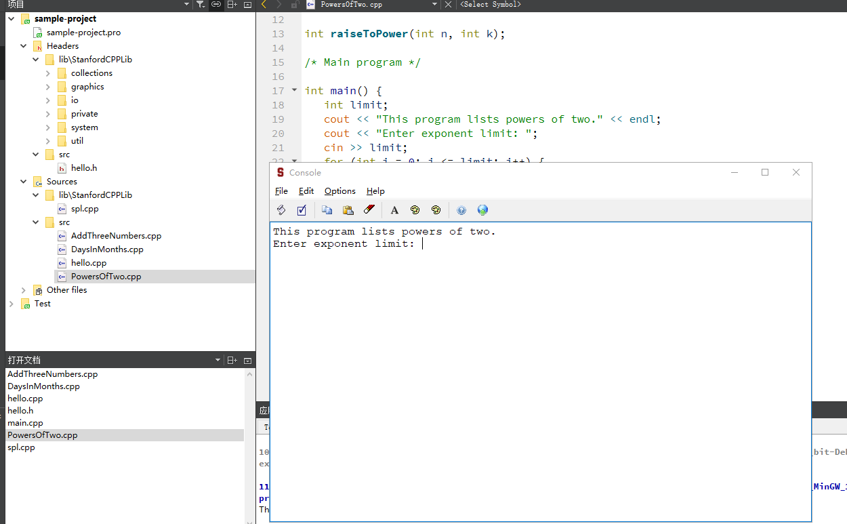
How to use The Stanford C++ Library ?
Add CPP files

Slide 37

How to use The Stanford C++ Library ?
Add CPP files

Slide 38
END

